Slide 1
Swift: Generate IDs using Twitter’s Snowflake Algorithm
ThanhNB – 08/2016
Head of Game Statistics – VNG
“biết chút chút Swift, không biết code iOS”

Slide 2
Thuật Toán Sinh ID Tốt

Slide 3
Thuật Toán Sinh ID Tốt
Unique
K-ordered
Decentralized
Simple

Slide 4
Twitter Snowflake

Slide 5
Twitter Snowflake (*)
Network service for generating IDs
Developed by Twitter
Open-sourced in 2010
(*) https://blog.twitter.com/2010/announcing-snowflake
(*) https://github.com/twitter/snowflake/tree/snowflake-2010

Slide 6
Twitter Snowflake (*)
Fast, Very Fast
Decentralized &
Uncoordinated
K-ordered
Time Ordered
(*) https://blog.twitter.com/2010/announcing-snowflake
(*) https://github.com/twitter/snowflake/tree/snowflake-2010

Slide 7
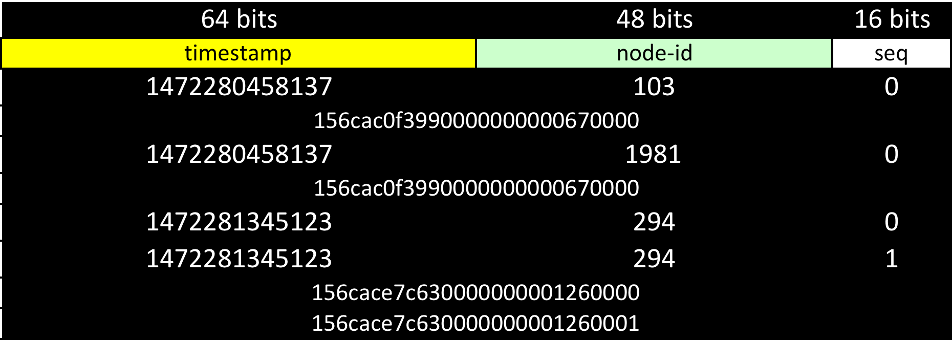
Twitter Snowflake – 128-bit

Slide 8
Twitter Snowflake – 64-bit

Slide 9
Twitter Snowflake – Swift, 64-bit
UInt64 → 41 bits timestamp
41-1 bits
Low Concurrency → 23 bits node-id
sequence

Slide 10
Twitter Snowflake – Swift, 64-bit

Slide 11
Twitter Snowflake – Swift, 64-bit
public class SnowflakeIdGenerator {
private static let MASK_TIMESTAMP_64 :UInt64 = (1 << 41) - 1
private static let MASK_NODE_ID_64 :UInt64 = (1 << 23) - 1
private static let SHIFT_TIMESTAMP_64 :UInt64 = 23
private static let TIMESTAMP_EPOCH :UInt64 = 1456790400000
private var nodeId :UInt64 = 0
private var template64 :UInt64 = 0
private var sequenceMillisec :UInt64 = 0
private var lastTimestampMillisec :UInt64 = 0
....

Slide 12
Twitter Snowflake – Swift, 64-bit
init(_ nodeId: UInt64 = 0) {
if ( nodeId != 0 ) {
self.nodeId = nodeId
} else {
self.nodeId = UInt64(UIDevice.current.identifierForVendor!.hashValue)
}
template64 = (self.nodeId & SnowflakeIdGenerator.MASK_NODE_ID_64)
}

Slide 13
Twitter Snowflake – Swift, 64-bit
public func generateId64() -> UInt64 {
let timestamp: UInt64 = DateTimeUtils.currentUnixTimestampMillisec()
if (timestamp == self.lastTimestampMillisec) {
DateTimeUtils.waitTillNextMillisec(timestamp)
return self.generateId64()
} else {
self.lastTimestampMillisec = timestamp
}
let tPart = (timestamp - SnowflakeIdGenerator.TIMESTAMP_EPOCH) & SnowflakeIdGenerator.MASK_TIMESTAMP_64
let result = tPart << SnowflakeIdGenerator.SHIFT_TIMESTAMP_64 | self.template64
return result
}

Slide 14
Twitter Snowflake – Swift, 64-bit
public static func currentUnixTimestampMillisec() -> UInt64 {
return UInt64(NSDate().timeIntervalSince1970 * 1000)
}
@discardableResult public static func waitTillNextMillisec(_ currentMillisec: UInt64) -> UInt64 {
var nextMillisec = currentUnixTimestampMillisec()
while ( nextMillisec <= currentMillisec ) {
nextMillisec = currentUnixTimestampMillisec()
}
return nextMillisec
}

Slide 15
Twitter Snowflake – 128 bit
Easy!

Slide 16
Code & Demo
Code available on Github:
https://github.com/btnguyen2k/swiftutils

